Slide 1
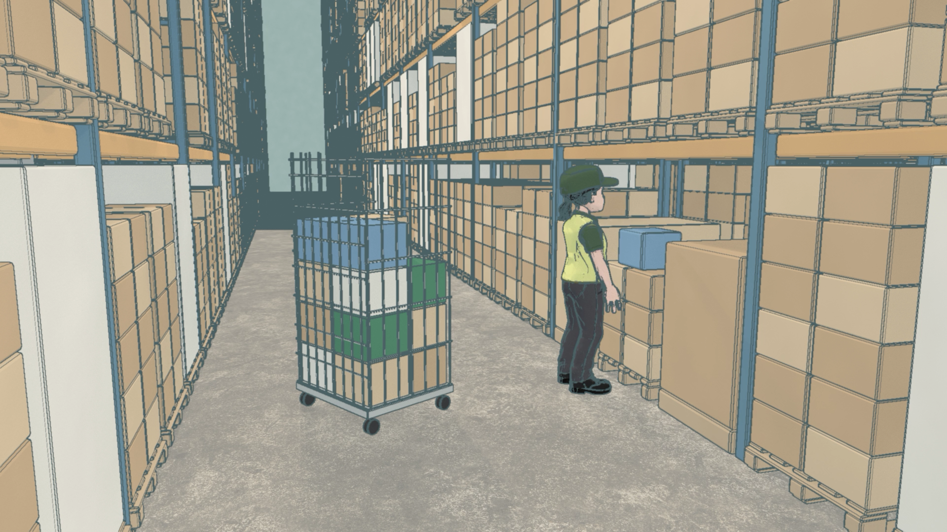

Slide 2
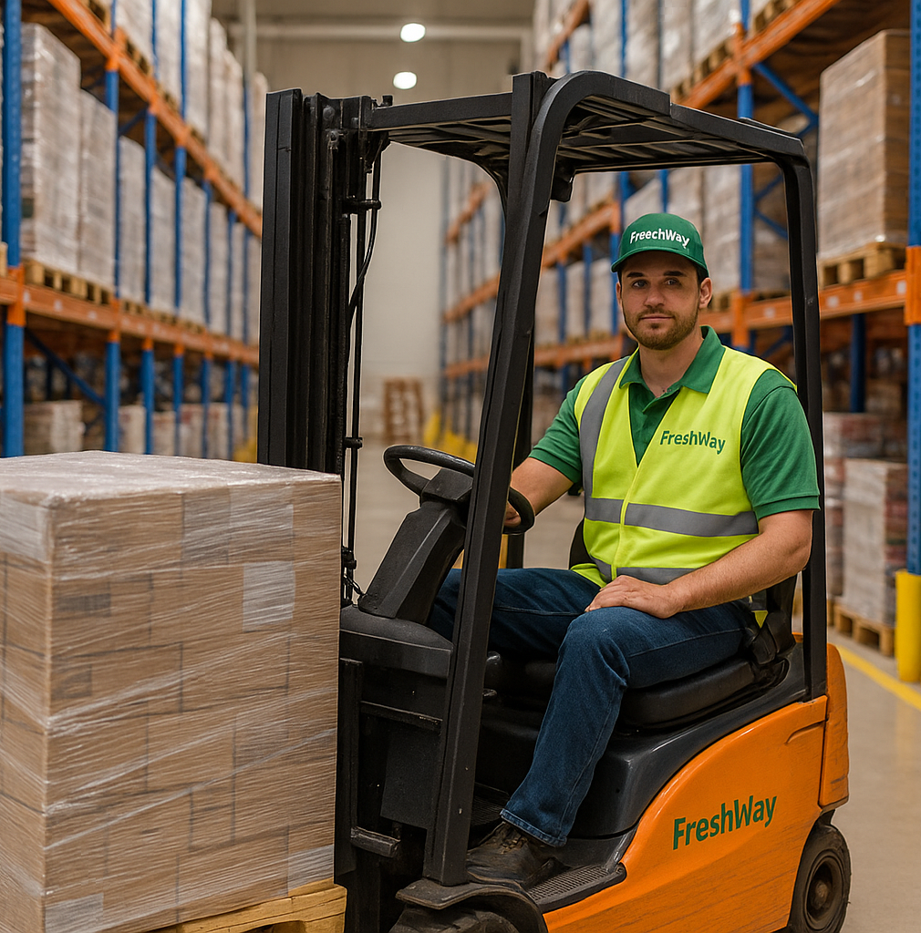
Smart logistics
Lesson 3 – Data Driven logistics
Minor SCE

Slide 3

Course Overview
Smart logistics
1 Introduction and company start-up
2 Smart logistics and business intelligence
3 Data driven logistics
4 Digital developments
5 AI and GenAI in logistics
6 Self organising logistics
7 Sensors and smart supply chains
8 Consolidation and alignment
9 To be announced
Notes:
Standardised nine-topic list, canonical English wording from the lesson-concept document (Sept 2026).
If the nine-lesson concept is not adopted, delete this slide and keep the old one.

Slide 4
Today
Lesson 3
08:45
20′
Board opening: commitments, Board Memos and your plans
09:05
50′
Masterclass: data driven logistics
09:55
10′
Break
10:05
35′
The five bodies: the first Interface Agreements
10:40
30′
Department work: start your data model
11:10
5′
Board close: your commitment for lesson 4
Notes:
08:45 · agenda, 30 seconden
Loop de agenda kort door. Les 3 is de eerste les die het standaardritme van 150 minuten volgt zonder afwijking: Board opening met doorloop van de toezeggingen 20, masterclass 50, pauze 10, de vijf organen gelijktijdig 35, afdelingswerk 30, Board close 5. Oranje is het blok aan de eigen tafel.

Slide 5

What is data driven logistics?
Smart Logistics
Data-driven logistics refers to the use of data analysis and insights to optimize logistics operations.
By leveraging real-time and historical data, companies can make informed decisions, improve efficiency, reduce costs, and enhance overall performance.

Slide 6

Goal of today
Smart Logistics
Identify the types of data needed to make FreshWay’s operations smarter.
Understand how IT landscape and architecture provide the foundation for smart logistics

Slide 7
Board opening and commitments
Lesson 3 · Board opening
Frits Coers
CEO Operations & Technology
1 The Board walks through the Decision Log. You may correct us.
2 Each manager on the lesson 2 commitment: met · not met and why · adjusted in advance
Wilbur Hage
CEO Finance & Customer
3 Your Board Memos, and feedback on your research plans. One department presents.
Adjusting in advance costs nothing. Staying silent is the only real failure.
Notes:
08:45 · 20 min · beide docenten
Volgorde: (1) de Board loopt de Board Decision Log door; studenten mogen ons corrigeren. (2) Elke Department Manager beantwoordt de toezegging uit les 2: gehaald, niet gehaald en waarom, of vooraf bijgesteld. Het antwoord gaat in de MT-notulen. Heeft een andere afdeling niet geleverd, dan is de Non-Delivery Notice het instrument, en die wijst naar de gedateerde regel in de notulen van les 2. (3) De Board Memo's uit les 2 en de formatieve feedback op de zeven onderzoeksplannen (SA1). Daarna presenteert één afdeling haar plan: dia's Presentation time en Feedback on your research plans.
De vier regels die het formatief houden: vooraf bijstellen kost niets en wordt genoteerd, niet aangerekend; zwijgen is het enige echte verzuim; een gemiste toezegging die een ander raakt, kan een Non-Delivery Notice opleveren; twee gemiste toezeggingen zonder bijstelling zijn een aanleiding voor de scopeverkleining in les 6. Geen cijfer tijdens de rit.
[OPEN: de verdeling van de 20 minuten over doorloop, memo's, feedback en de presentatie. Dat is krap: zeven toezeggingen, zeven plannen en één presentatie.]

Slide 8

Presentation time
Present your research plan

Slide 9

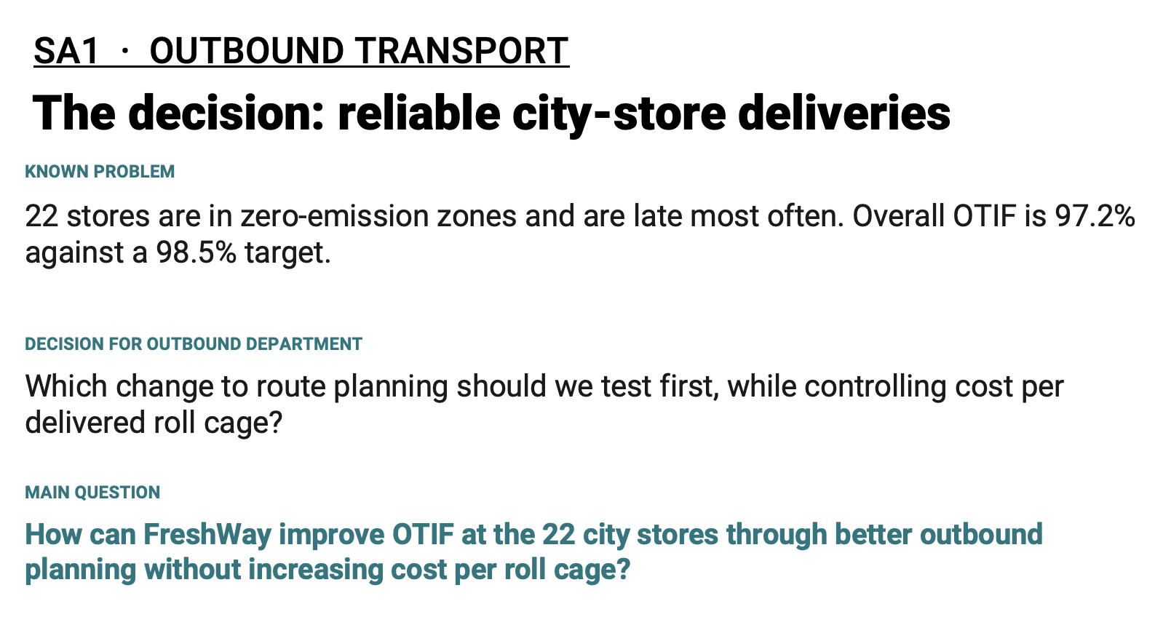
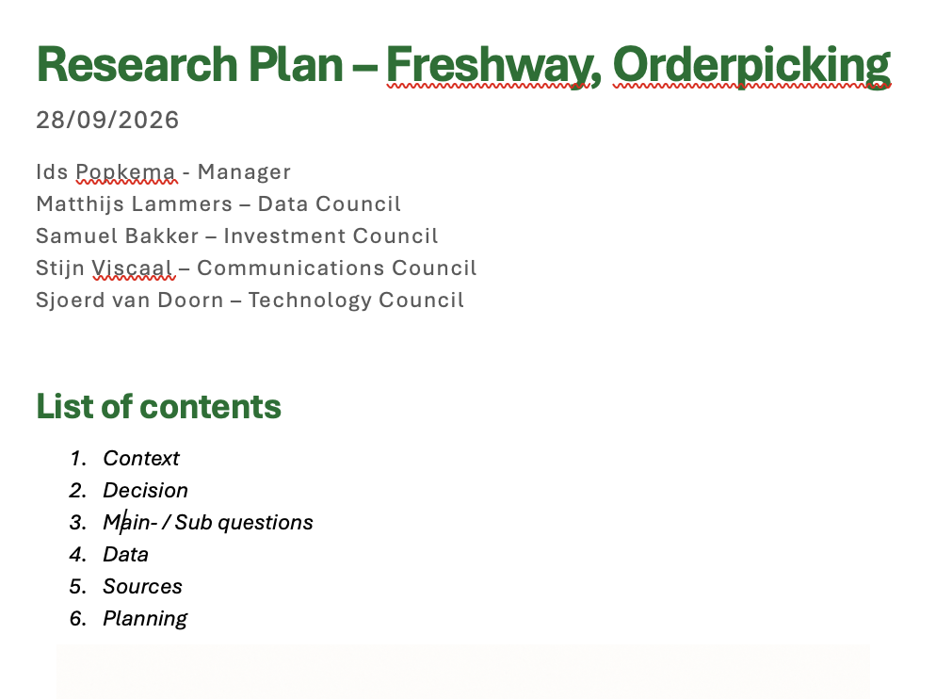
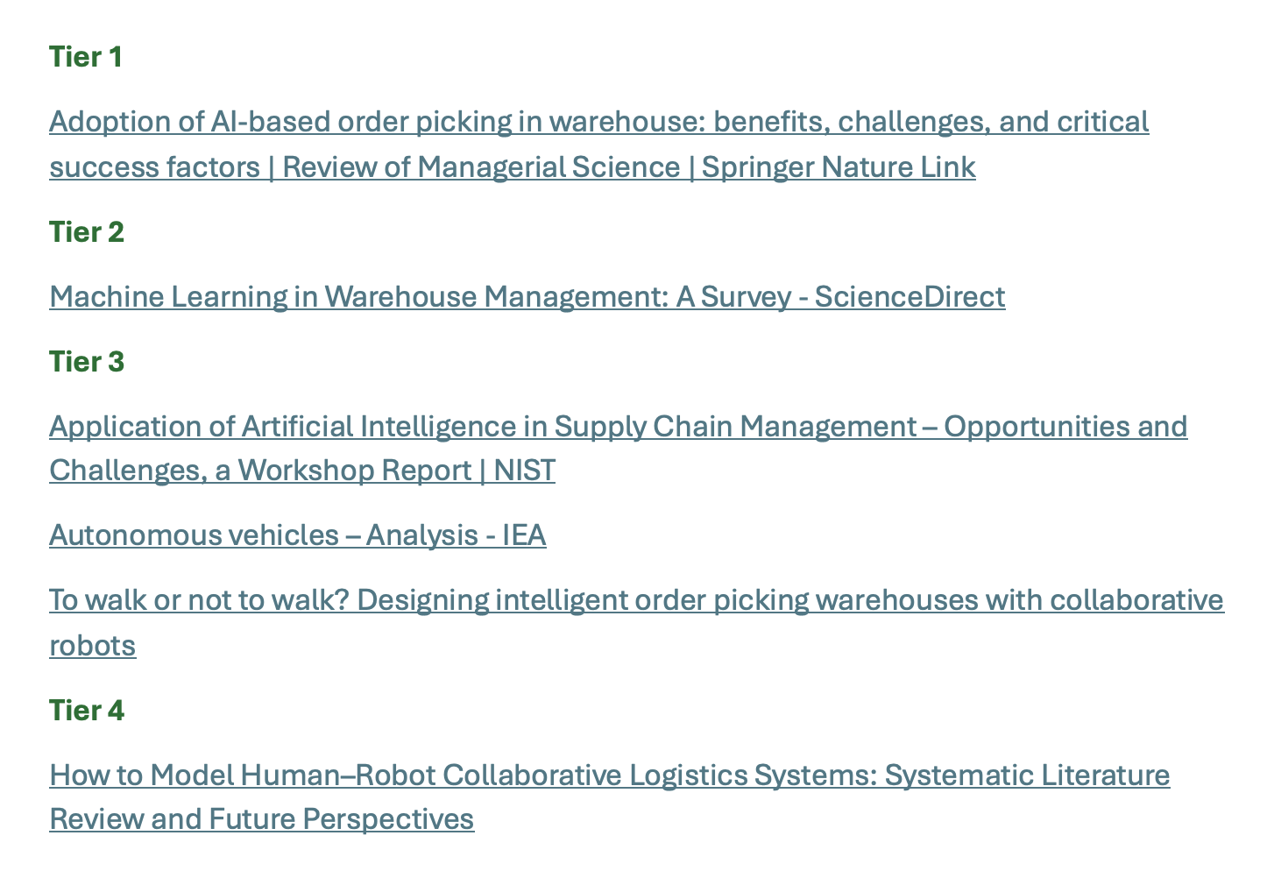
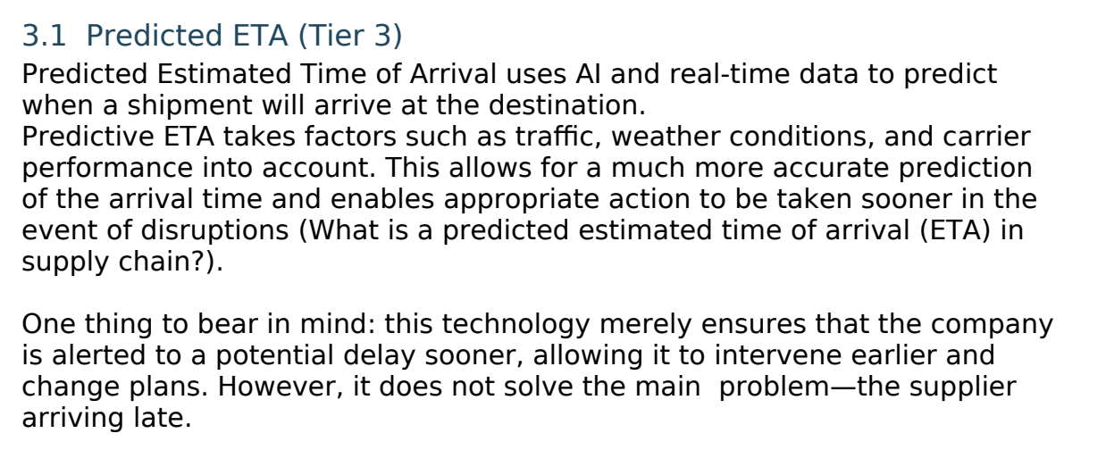
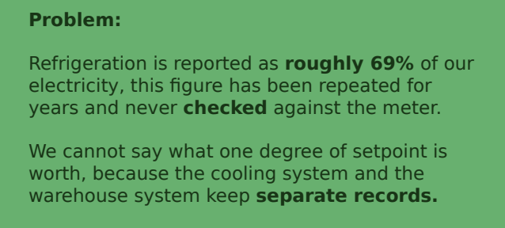
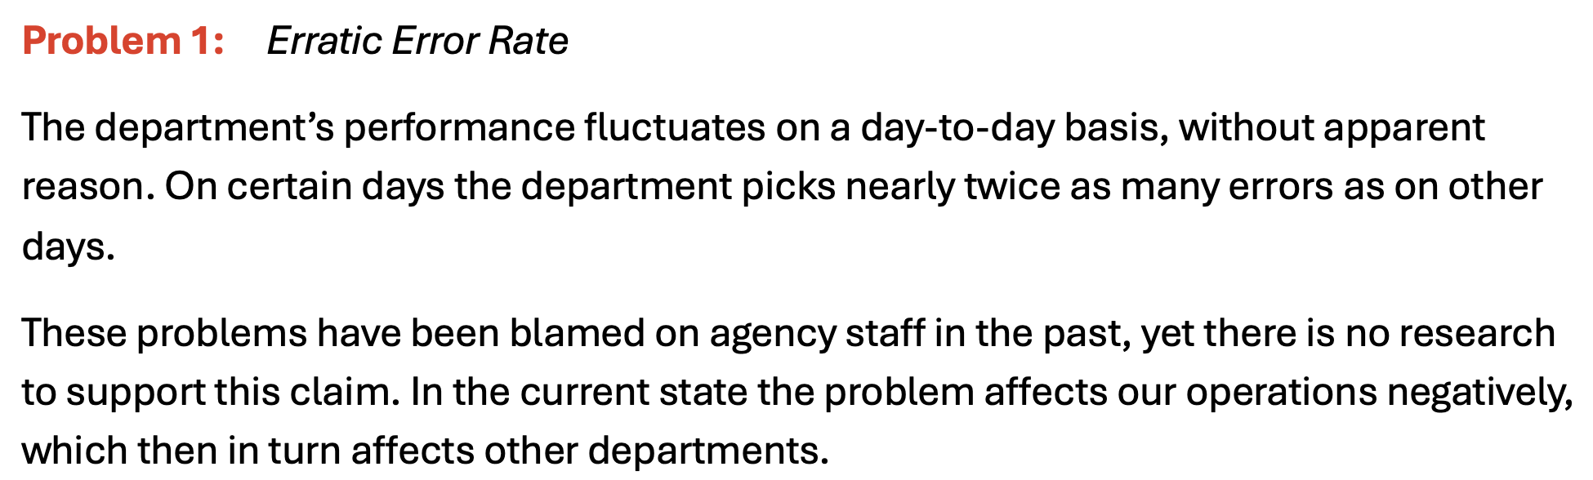
Feedback on your research plans
Overall feedback
Professional document layout
Traceable reasoning
Evidence
Sources
GenAI declaration

Slide 10
Board decision
How to work in 2026

Slide 11
Why we change the reporting standard
Lesson 3 · Board opening · Board Decision
1
In SA1 we saw long Word documents, much of it fluent GenAI text
2
Length tells the Board nothing about what you know or checked
3
A board is convinced by one insight, with a number and a source
So from SA2 on we assess content, not word count.
Notes:
Board opening · Board Decision 1/4 · 2 min · Frits
Aanleiding: bij SA1 leverden veel afdelingen een lang Word-document in, voor een groot deel vloeiende GenAI-tekst. Geen verwijt: GenAI mag en wordt aangemoedigd. Maar lengte laat niet zien wat je weet of wat je hebt gecontroleerd, en wij willen geen veertig pagina's nakijken om dat te vinden.
Wat een directie wél overtuigt: één inzicht, met een getal en een bron. Daarom telt vanaf SA2 de inhoud en niet het aantal woorden. Frits' eigen woorden: de inhoud moet kloppen, de bronnen en de redenering moeten helder zijn.

Slide 12
Board Decision: reporting standard
Lesson 3 · Board opening · Board Decision
1
Free form from SA2 on: a report, a board deck, a website, or a mix
2
Every claim your advice rests on has a source (APA7), or the label “Assumption”
3
Show the reasoning: from data or source, via calculation or argument, to conclusion
4
A rubric map with evidence appendix; for a website a dated snapshot
No word limit. Content counts: correct, sourced, easy to follow.
Notes:
Board opening · Board Decision 2/4 · 3 min · Frits
Board Decision "Reporting standard", in de Decision Log onder het volgende nummer [nummer invullen]. Geldt vanaf SA2 voor de wekelijkse inleveringen en voor het eindproduct. Opdracht, studiewijzer en rubric zijn aangepast en staan op Brightspace.
Wat er in de knock-outs staat: kernclaims herleidbaar (APA7 voor verwijzingen en literatuurlijst, niet voor de opmaak) of gelabeld "Assumption"; de stap van data naar conclusie zichtbaar; een rubric map met de bewijsbijlage voor criterium 5; bij een website een momentopname met datum (zip of PDF-export), want die wordt beoordeeld en bewaard. Het rapport met voorwoord, managementsamenvatting en 10.000 woorden vervalt.
SA2 is een data flow diagram en dus al een beeld: de tekst legt alleen uit wat het diagram niet laat zien.

Slide 13
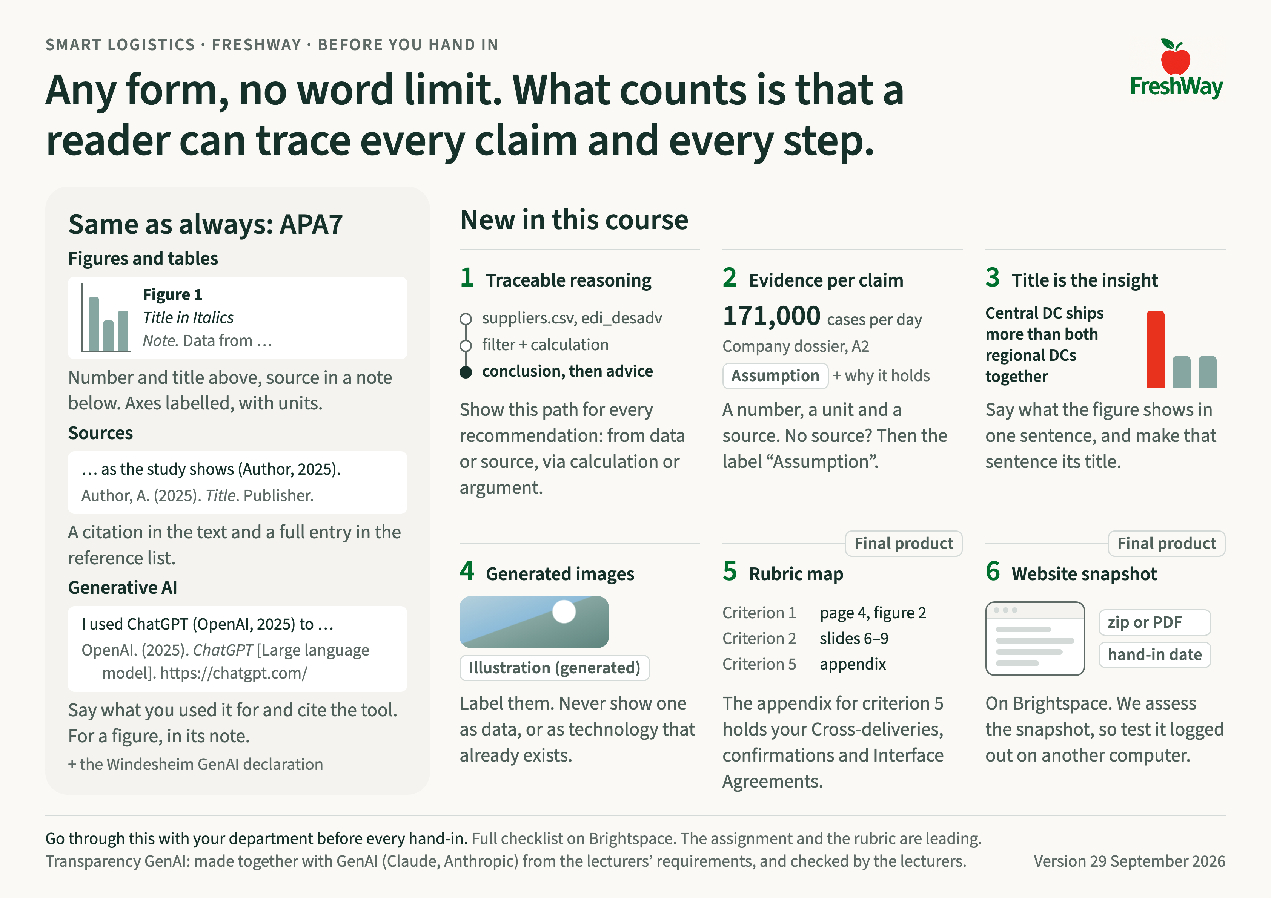

Slide 14
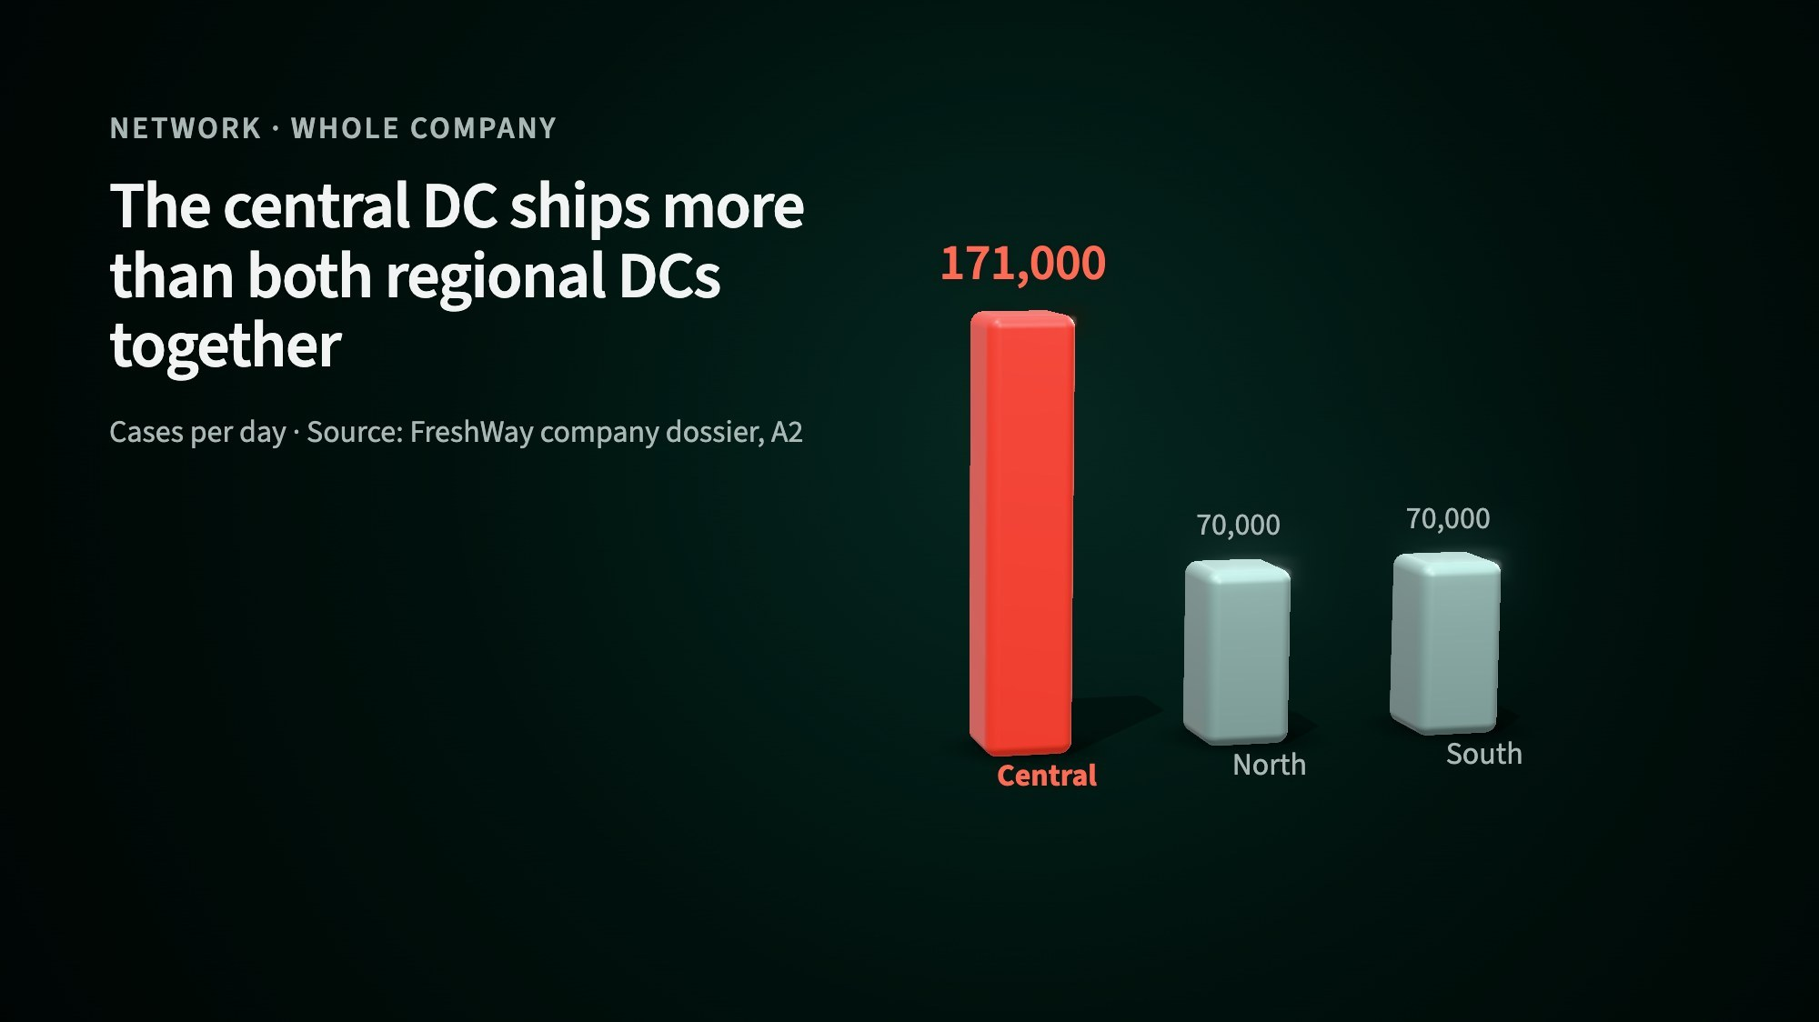
What one insight can look like
Lesson 3 · Board opening · Board Decision
1
Title: the insight in one sentence
2
Key number large, with its unit
3
Source right under it
From the FreshWay style guide. A flat chart counts just as much.
Notes:
Board opening · Board Decision 3/4 · 2 min · Frits
Wijs de drie dingen aan op het beeld: de kop zegt de conclusie (het centrale DC verstuurt meer dan de twee regionale samen), het getal staat groot met eenheid (colli per dag), en de bron staat eronder (bedrijfsdossier A2). Dek de grafiek af: de kop blijft waar. Dat is de toets.
Gemaakt met het FreshWay-styleguidepakket en een AI-agent; de voorbeeldprompts staan in de README van het pakket. 3D is niet verplicht: een platte grafiek in Excel of Power BI in de FreshWay-kleuren telt even zwaar, want de rubric beloont het inzicht en niet de techniek. Een gegenereerd beeld dat geen data toont, krijgt het label "Illustration (generated)".

Slide 15


Slide 16
How this was created
Put all the FreshWay files in one folder on your computer
  Company file
  Datasets
Within ChatGPT Work or Claude Cowork, add the folder to your project
Prompt: Build a 3D animation of the most important data of FreshWay from the general dataset, not from the different departments. Come up with a FreshWay dashboard style and make an example 3D animation that shows a metric

Slide 17
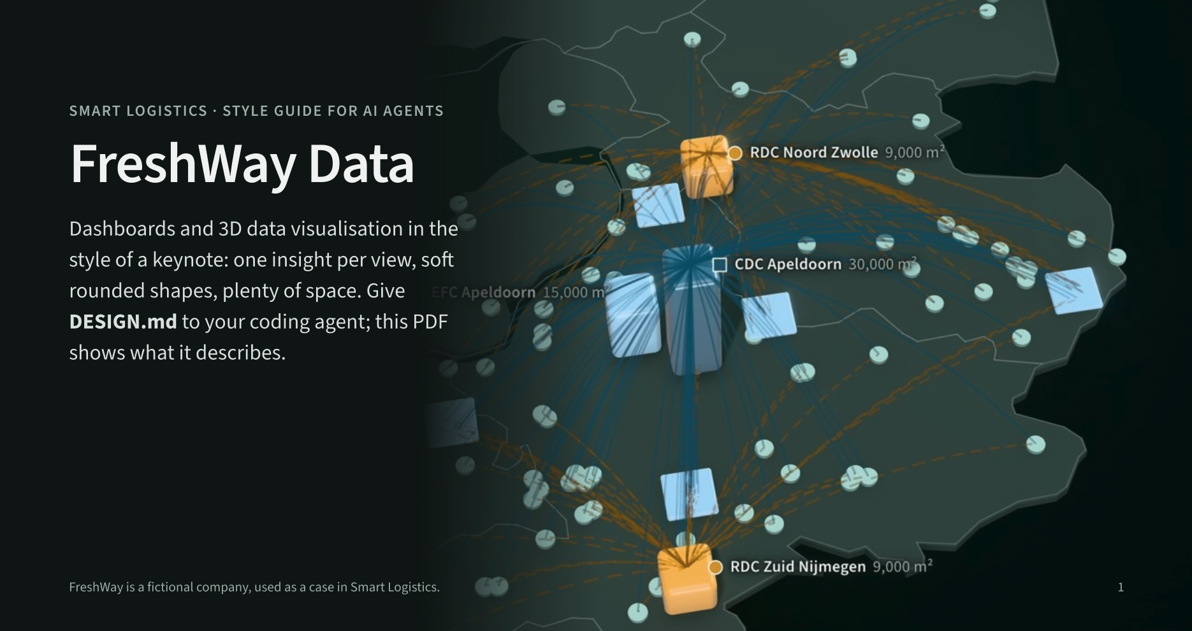
FreshWay styleguide
Available on Brightspace

Slide 18
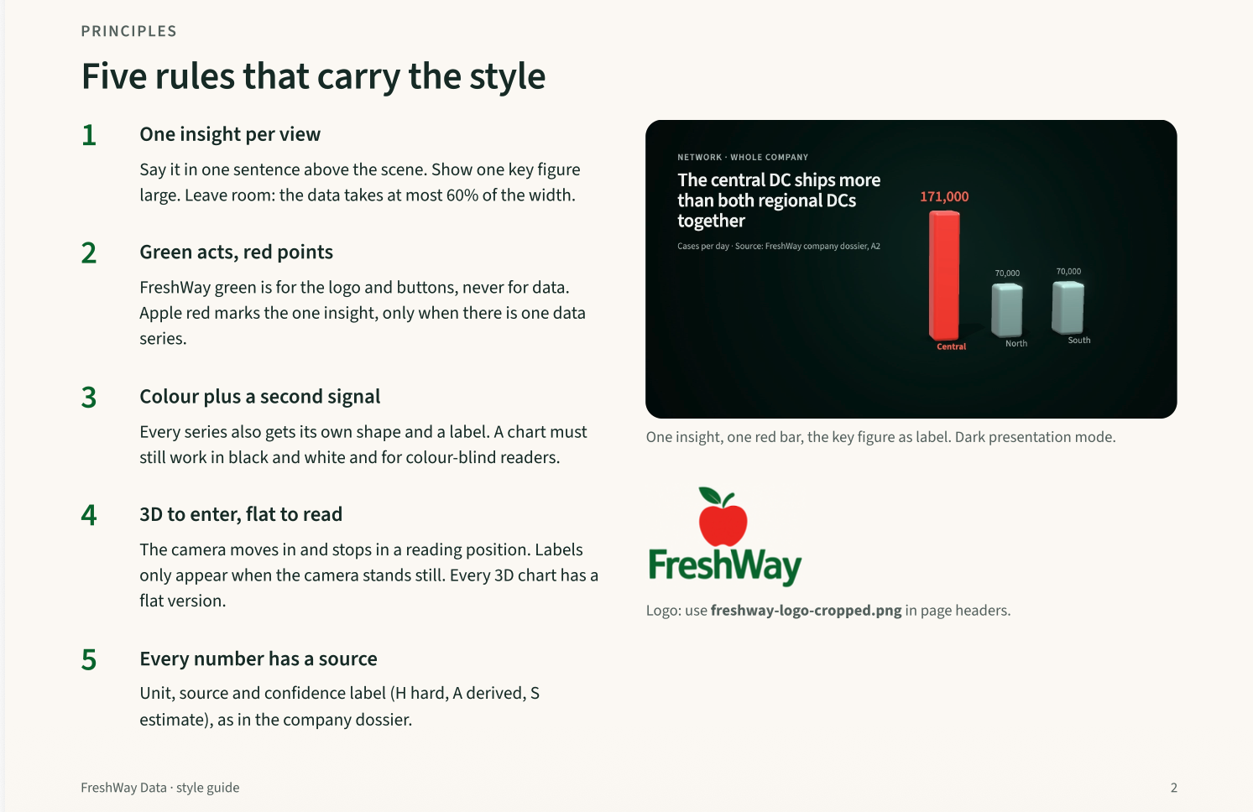
FreshWay styleguide
Available on Brightspace

Slide 19
Before you hand in
Lesson 3 · Board opening · Board Decision
1
Sources: every key claim has a source or the label “Assumption”
2
Figures: the insight as title; generated images say “Illustration (generated)”
3
Evidence: rubric map and appendix for criterion 5; website: dated snapshot
4
GenAI: the Windesheim declaration
The full Rubric map and evidence appendix template is on Brightspace. Go through it before every hand-in.
Notes:
Board opening · Board Decision 4/4 · 1 min · Frits
De checklist "Before you hand in" staat op Brightspace [plek invullen], één A4. De afdeling loopt hem na vóór elke inlevering.
Tijd: deze vier dia's en de SA1-dia samen ongeveer tien minuten.

Slide 20
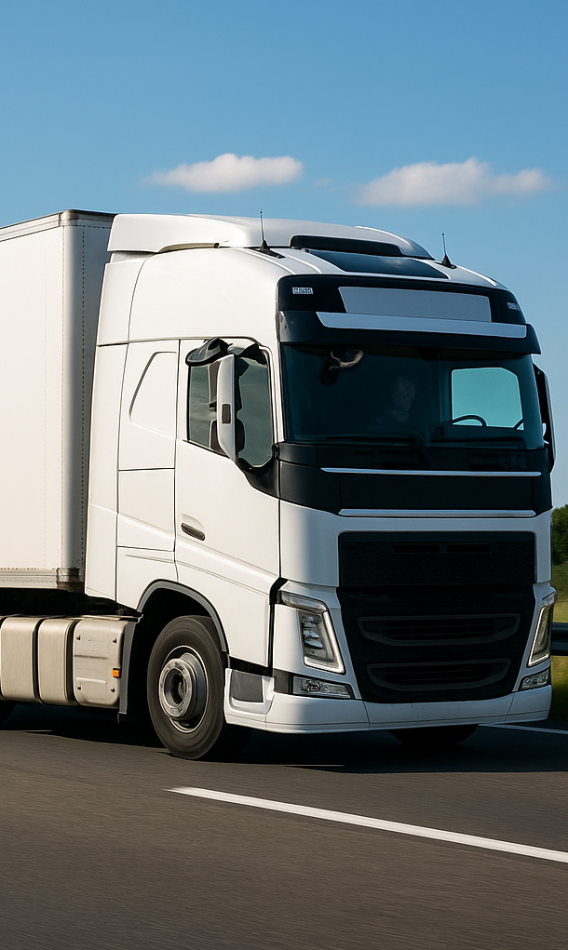
Program of today
Smart Logistics
Architecture
Logistic systems
Data flow diagrams
Data analyses
Platforms

Slide 21

Why Smart Logistics?
Challenges & Drivers: globalisation, sustainability, digitalisation
Customer Expectations: faster, cheaper, greener solutions
Data as Fuel: Logistics = data-driven decision making
Tech Impact: AI, IoT, robotics, e-business, platform economy
Opportunities: Lower costs, faster & flexible processes, accessible for SMEs
Class Goal:
  Understand key tech & market developments
  Identify added value & opportunities of Smart Logistics for our companies
  Learn from best-in-class solutions and applications
  Apply insights in a group project (FreshWay)

Slide 22
Why Smart Logistics?
Challenges & Drivers: globalisation, sustainability, digitalisation
Customer Expectations: faster, cheaper, greener solutions
Data as Fuel: Logistics = data-driven decision making
Tech Impact: AI, IoT, robotics, e-business, platform economy
Opportunities: Lower costs, faster & flexible processes, accessible for SMEs
  Next step: To turn opportunities into reality, companies need a solid IT landscape & architecture.
  This is the basis: without the right systems and structure, smart logistics innovations cannot succeed.

Slide 23
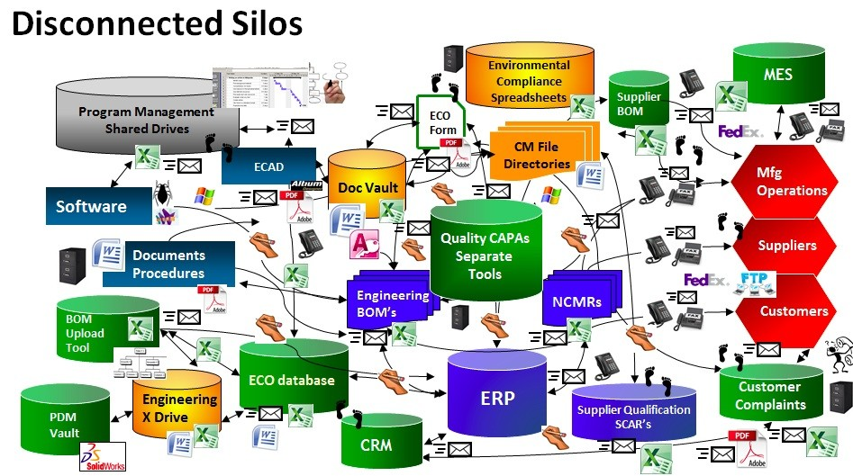
Motivation architecture blueprint
Smart logistics brings IoT, AI and automation into already complex chains.
If we connect everything ad hoc, we create spaghetti-like systems and slow our companies down.
Impact: Slow to onboard new features, poor visibility, security risks, higher cost (maintenance/incidents) and low reliability,
Solution: Create a clear architecture blueprint to scale and evolve
Spaghetti-IT-Landscape: An IT landscape where systems are connected ad hoc, point-to-point, with no shared standards, no central integration layer, and no clear data model.
Often a large number of Excel sheets and isolated apps

Slide 24
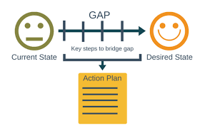
Motivation architecture blueprint
What is a blueprint?
A blueprint is the high-level specification of a system’s structure—its key building blocks, how they connect, and the rules/standards that govern them.
~ IT – Landscape
  A descriptive map of what you currently have: systems (ERP, WMS, TMS, YMS, portals), integrations (APIs/EDI), data stores, etc.
  As is
~ Architecture
  the prescriptive structure & decisions: principles, patterns, quality goals (scalability, security), target state, and the rationale + roadmap to evolve the landscape.
  To be
Notes:
A blueprint is the high-level specification of a system’s structure—its key building blocks, how they connect, and the rules/standards that govern them—so teams can build and evolve the system consistently.
What it contains (essentials):
Elements: services/systems (ERP, WMS, TMS, IoT, data platform)
Relationships: data flows, APIs, events, integrations
Standards & rules: naming, IDs, schemas, security, versioning
Quality targets: scalability, reliability, latency, cost, security
Decisions & principles: why we chose event-driven, API-first, cloud/edge, etc.
What it’s not:
Not code or detailed configs
Not UI wireframes
Not a vendor price list
Not a project plan (that’s the roadmap)
How it relates to other docs:
Reference architecture: reusable template (generic)
Blueprint / Target architecture: the chosen structure for this organization/domain
Solution design: detailed design of specific components inside that blueprint
Roadmap: time-phased steps to reach the blueprint

Slide 25
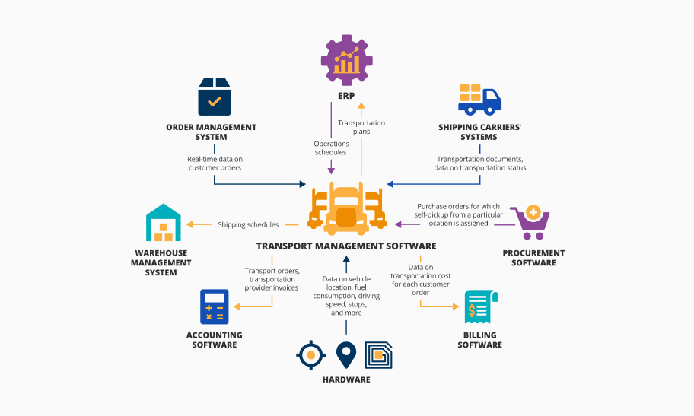
What is Architecture?
Architecture is the big-picture blueprint of a system: the key parts, how they fit together, and the rules and decisions that guide how the system is built and evolves
Core Elements
Building blocks and systems (e.g., WMS, TMS, data stores, devices).
Relationships: how those blocks interact (events, APIs, data flows).
Principles & constraints: rules that shape design (e.g., “API-first,” “event-driven”).
Quality attributes (non-functionals): scalability, reliability, security, interoperability, maintainability, cost

Slide 26
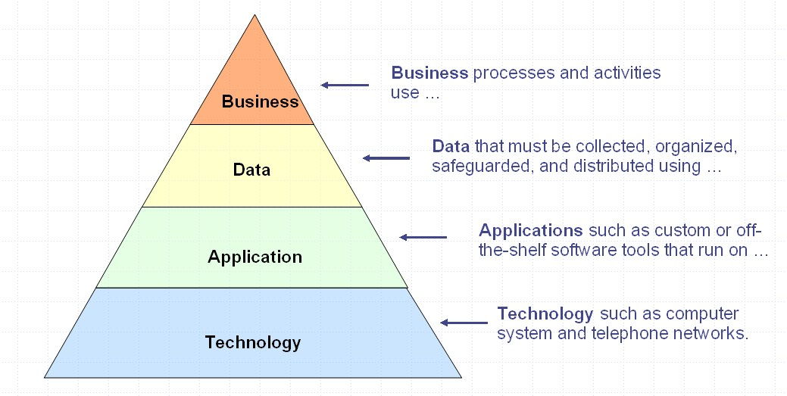
Architecture model
We use the 4-layer model as a structure that makes complex logistics systems understandable, governable, and changeable {based on TOGAF):cx
Business layer – goals, processes, KPIs (e.g., faster delivery, sustainability).
Information layer – data flows (orders, inventory, IoT sensor data).
Application layer – systems (ERP, WMS, TMS, IoT platforms, analytics).
Technology layer – infrastructure (cloud, databases, networks, devices).
TOGAF (The Open Group Architecture Framework) is a widely used framework for enterprise architecture that helps organizations design, plan, and govern their IT infrastructure to align with business goals
Notes:
Business Layer (goals, processes, KPIs)
Purpose: tie IT decisions to logistics outcomes.
Typical value streams: Order-to-Cash, Procure-to-Pay, Inbound, Put-away, Replenishment, Picking, Packing, Shipping, Returns.
KPIs: OTIF, lead time, dwell time, cost per drop, dock utilization, pick rate, inventory accuracy, CO₂ per shipment.
Constraints: SLAs, temperature compliance (cold chain), traceability, customs, driver hours, sustainability targets.
Deliverables: capability map (e.g., “Transport Planning,” “Yard Orchestration”), process models (BPMN), KPI tree.
Information Layer (data, semantics, governance)
Data classes:
Master: products (SKUs), locations (GLNs), customers, suppliers, vehicles, drivers, assets (pallets, totes).
Transactional: orders, shipments, loads, tasks, dock bookings, ASN/GRN, invoices.
Telemetry/time-series: temperature, humidity, GPS, fuel, vibration, battery, door open/close.
Reference: calendars, routes/lanes, service levels, cut-offs, geofences.
Event vs. state: model events (“ShipmentDeparted”) and state (“shipment.status=IN_TRANSIT”). Use events to drive near-real-time reactions; use state for reporting.
Canonical data models: define a shared schema (IDs, timestamps, units, time zones). Aim for a small but stable “logistics core” (Shipment, Stop, HandlingUnit, Reading, Resource).
Semantics & standards (examples): GS1 identifiers (GTIN, SSCC, GLN), EPCIS for event capture, UN/EDIFACT, ISO 8000 (data quality), ISO 8601 (time), WGS84 (geo).
Data quality & governance: ownership (who is data steward?), lineage (where did this KPI come from?), PII handling, retention, golden records (MDM).
Application Layer (systems & boundaries)
Core systems and roles:
ERP: order mgmt, finance, inventory ledger.
WMS/WES: location control, tasks, waves, AMR orchestration.
TMS: rating, tendering, routing, execution, freight audit.
OMS: multi-channel promise, ATP/CTP.
YMS/Gate: yard visibility, dock scheduling.
MDM: golden master for product/party/location.
B2B/B2G: EDI/API gateways (carriers, marketplaces, customs).
IoT/Device mgmt: sensor registry, firmware, shadow state.
Analytics/AI: BI, forecasting, optimization services.
Bounded contexts: keep systems responsible for one language (e.g., WMS “task” vs TMS “stop”). Integrate via contracts, not database sharing.
External ecosystems: carrier APIs, telematics, marketplaces, 3PLs—treat as partner contexts with explicit SLAs and retry policies.
Technology Layer (platform, infra, connectivity)
Compute & storage: cloud (IaaS/PaaS/SaaS), container platforms, serverless for bursty workloads, edge nodes in DC/yard/vehicles for low latency.
Datastores: relational (orders), document (labels, JSON), time-series (telemetry), graph (network), object storage (data lake, labels, photos).
Streaming & integration: message brokers (Kafka, Pulsar), MQTT for IoT, iPaaS/ESB for B2B, API gateways.
Networks: Wi-Fi 6 in WH, private 5G for mobility/coverage, LPWAN (LoRaWAN/NB-IoT) for low-power sensors, secure VPNs with partners.
Security & identity: IAM (RBAC/ABAC), OAuth2/OIDC, mTLS, secrets mgmt (HSM/KMS), zero-trust network access.
Ops: CI/CD, Infrastructure as Code, backup/restore, disaster recovery tiers, observability stack (logs/metrics/traces), SLOs.

Slide 27
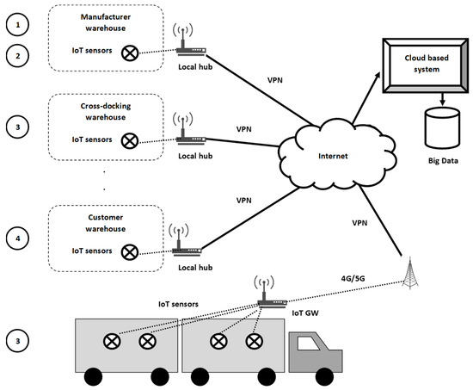
Architecture principles
Smart logistics
Integration — APIs, middleware, EDI, microservices.
Real-time vs. batch — streaming IoT data vs. nightly ERP sync.
Data centralization — data lakes & warehouses.
Scalability & flexibility — cloud vs. on-prem.
  Since 12 January 2027 cloud providers may charge nothing for switching, including data egress (EU Data Act). One of the biggest hidden costs of the wrong choice disappears.
Security & reliability — especially important in logistics chains.
  Since 15 August 2026 this has a legal basis: the Dutch Cyberbeveiligingswet (NIS2). It is no longer only good practice.
Notes:
Change: two lines added, one under 'Scalability & flexibility' and one under 'Security & reliability'.
Sources: Onno, research block A3 §3.1 and §3.2. Recheck: January 2027.
NOT COPIED from the old slide: the API explanation text box ('An API is a set of rules and tools...'). It is in the speaker notes of the old slide; move it here if you want to keep it on screen.

Slide 28
Regulation shaping smart logistics (1/2)
Already in force — status 20 August 2026
2 Feb 2025 — EU AI Act: prohibited AI practices apply.
2 Aug 2025 — EU AI Act: obligations for providers of general-purpose AI models apply.
12 Sep 2025 — EU Data Act: main provisions apply. Users of connected products gain the right to access the data those products generate and to have it shared with a third party of their choice.
2 Aug 2026 — EU AI Act, Article 50: people must be told when they interact with an AI system; an AI agent must disclose that it is AI and on whose behalf it acts.
15 Aug 2026 — Netherlands, Cyberbeveiligingswet (NIS2): around 8,000 organisations in 18 sectors, including food production, processing and distribution, and transport.
Notes:
New slide, no predecessor. Source: Onno, research block A3 part 2. Status of the dates: 20 August 2026. Recheck: February 2027.
Items marked with a triangle can still move: the high-risk AI dates were already postponed once by the Digital Omnibus (Regulation (EU) 2026/1744). A second package, the 'Data Omnibus', is still under negotiation.
This is the most reusable addition in the course — call it up again in Lessons 3, 4 and 6.

Slide 29
Regulation shaping smart logistics (2/2)
Coming up — dates as adopted
12 Sep 2026 — EU Data Act: connected products placed on the market after this date must be accessible-by-design — free, secure, structured, machine-readable.
2 Dec 2026 — EU AI Act: watermarking obligations for AI-generated content.
12 Jan 2027 — EU Data Act: cloud providers may no longer charge switching fees, including data egress.
9 Jul 2027 — eFTI: authorities in every Member State must accept freight information shared electronically. A right for business, not an obligation — paper stays valid.
2 Dec 2027 ▲ — EU AI Act: stand-alone high-risk systems (Annex III), including task allocation and monitoring of worker performance and behaviour.
2 Aug 2028 ▲ — EU AI Act: high-risk AI embedded in regulated products (Annex I).
▲ Still moving. Treat these as directionally right, not final.
Notes:
New slide, no predecessor. Source: Onno, research block A3 part 2. Status of the dates: 20 August 2026. Recheck: February 2027.
Items marked with a triangle can still move: the high-risk AI dates were already postponed once by the Digital Omnibus (Regulation (EU) 2026/1744). A second package, the 'Data Omnibus', is still under negotiation.
This is the most reusable addition in the course — call it up again in Lessons 3, 4 and 6.

Slide 30
EU Data Act — who owns the sensor data?
In force since 12 September 2025
Users of connected products have the right to access the data those products generate, and to have it shared with a third party of their choice.
Vendor lock-in in cloud services is prohibited; data portability within 30 days.
From 12 September 2026: products placed on the market after that date must be accessible-by-design — free, secure, structured, machine-readable, and directly from the device where technically feasible.
For your design: when you specify a sensor, a telematics box or a forklift computer, ask not only what it measures but who owns the data and whether you can reach it without the vendor.
Sources: European Commission, Data Act explained; Open Logistics Foundation (2025). Recheck: Jan 2027.
Notes:
New slide, no predecessor. Source: Onno A3 §3.2. Recheck: January 2027.
This changes the design question the students ask: not 'which sensor do I buy' but 'whose data is it and can I reach it'. It connects Lesson 3 (architecture) to Lesson 7 (sensor application canvas).

Slide 31
Cyberbeveiligingswet (NIS2)
In force since 15 August 2026
The Dutch implementation of NIS2. Around 8,000 organisations in 18 sectors — including “food: production, processing and distribution” and transport.
Thresholds: from 50 staff or EUR 10m turnover (important entities); from 250 staff or EUR 50m (essential entities, active supervision).
Duties: register; manage security risks proportionately; report significant incidents — early warning within 24 hours, fuller report within 72 hours, final report within a month; train board members.
For your design: every system you connect widens the attack surface of an organisation that now has a legal duty of care. Can your solution report a significant incident within 24 hours? What does compliance cost, and is it in your business case?
Notes:
New slide, no predecessor. Source: Onno A3 §3.1. Recheck: August 2027.
Open point Onno deliberately left open: whether a supermarket chain falls exactly under the sector definition ('wholesale and industrial production and processing') depends on how you qualify the distribution activities. On size FreshWay is clearly in scope. Do not close that question for the students — it is a good one to have them argue.

Slide 32
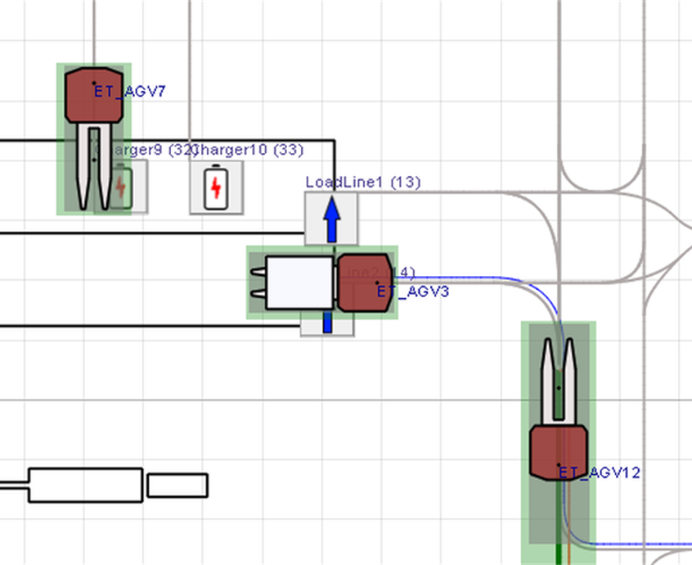
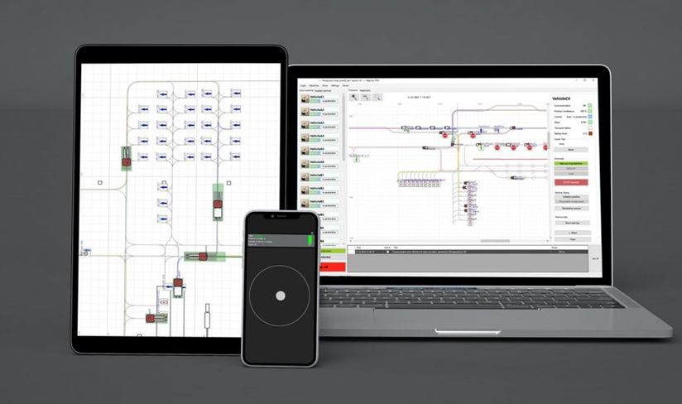
Example 1: AMR/Robot Orchestration in Fulfilment
Outcome/goal: Higher picking productivity. Safe robot operations. High uptime (robots available and working).
Architecture:
Business: 99.9% mission success, zero collisions.
Information: Tasks, warehouse map, traffic zones, robot health data (battery etc.).
Applications: WES (task orchestration), robot fleet manager, safety system, mission planner, maintenance system.
Technology: Edge controllers (local robot control), low-latency Wi-Fi or 5G, ROS2 for robot communication. Local broker for data. Cloud analytics for fleet KPIs.
Flow: WMS generates picking tasks. → WES assigns tasks to AMR fleet. → Fleet manager plans robot routes. → Robots send back MissionStatus. ( → Exceptions are reported to WMS)
Pitfalls: Unstable Wi-Fi, clock synchronization issues, no degraded mode (manual fallback missing).
WES: Warehouse Execution System: for task orchestration.
MissionStatus = the robot’s progress and results of its assigned task.
Fleet management software
Notes:
Robot Health Data
This refers to all the diagnostic information about the condition and performance of a robot. Examples include:
Battery status: charge level, charging cycles, battery temperature.
Sensor status: whether cameras, lidar, or other sensors are working correctly.
Motors and wheels: operating hours, wear indicators, error codes.
Network connection: Wi-Fi or 5G signal quality and stability.
Internal hardware temperature: overheating risks.
Error logs: emergency stops, crashes, or fault messages.
In short: robot health data = diagnostic data that helps fleet managers and maintenance teams predict failures and schedule service before breakdowns happen.
Edge Controllers (Local Robot Control)
These are computers or control units located close to the robot (“at the edge”) that handle time-critical tasks. They act as the local brain of the robot.
Real-time control: steering, braking, obstacle detection.
Sensor processing: reading lidar, cameras, gyroscopes, etc.
Fast response: decisions are made locally instead of waiting for the cloud (lower latency, safer).
Safety functions: robots can keep working even if the Wi-Fi/5G connection is lost.
In short: edge controllers = local intelligence, while the cloud handles fleet-level analytics and coordination.
ROS stands for Robot Operating System. Despite the name, it’s not an operating system like Windows or Linux, but more a middleware framework for robotics.
ROS provides a set of tools, libraries, and conventions that make it easier to build and control robots.
It helps different parts of a robot (sensors, motors, cameras, AI modules) communicate with each other.
It uses a publisher/subscriber model: for example, a camera “publishes” images, and a navigation module “subscribes” to use them.
ROS also includes simulation environments, debugging tools, and visualization (e.g., RViz).
There are two main versions:
ROS 1: the original, still widely used.
ROS 2: the modern version, designed for industrial use with better real-time support, security, and compatibility with standards like DDS (Data Distribution Service).
In short: ROS is like a common language and toolbox for robotics developers, so they don’t have to reinvent everything from scratch.
Low-latency Wi-Fi means a wireless network connection with very short delay (latency) between sending a signal and receiving a response.
Latency is the time it takes for data to travel from sender to receiver. In normal Wi-Fi, this might be tens of milliseconds, which is fine for web browsing but too slow for robots that need split-second reactions.
Low-latency Wi-Fi is tuned for real-time applications, such as controlling robots, autonomous mobile robots (AMRs), drones, or even VR/AR.
It reduces delay to just a few milliseconds, so instructions (like stop, obstacle ahead!) are executed almost instantly.
It’s often combined with Quality of Service (QoS) settings to guarantee that important robot-control data gets priority over less critical traffic (like video streaming).
In short: low-latency Wi-Fi = fast-response wireless network, critical for safety and coordination in robotics.
Robots send back MissionStatus”
When a robot (for example an AMR = Autonomous Mobile Robot) gets a task like “pick up pallet at A and bring to dock B”, that’s called a mission.
As the robot executes this mission, it regularly sends status updates back to the system.
Examples of MissionStatus messages:
Mission started
Currently driving to location A
Pallet picked up
Arrived at dock B
Mission completed successfully
Mission failed: obstacle blocking path
→ So: MissionStatus = the robot’s progress and results of its assigned task.
“Exceptions are reported to WMS”
An exception means something goes wrong or is different from the plan.
Examples:
Robot battery too low → cannot finish mission.
Dock is occupied → cannot unload.
Obstacle detected → path blocked.
These exceptions are sent back to the Warehouse Management System (WMS), so that:
A human operator can take action.
The WMS can reassign the task to another robot or worker.
In short: robots send regular progress updates (“MissionStatus”), and if something unexpected happens (an exception), the WMS is informed so the warehouse process can continue smoothly.
“No degraded mode (manual fallback missing)” means that the system has no backup plan if the robots or automation fail.
Degraded mode = a simplified or reduced way of working when the full system isn’t available.
Manual fallback = humans can take over tasks if robots or software stop working.
If this is missing, it means:
When robots stop (e.g. Wi-Fi down, software crash), nobody can quickly switch to manual work.
The warehouse may completely halt, because processes rely only on robots.
Example: If AMRs normally bring pallets to picking stations, but they fail, workers should be able to use manual forklifts as a fallback. If that option isn’t planned → operations get stuck.
In short: “No degraded mode” = the system can’t keep running in a simpler way when problems happen, because manual backup processes are not in place.

Slide 33
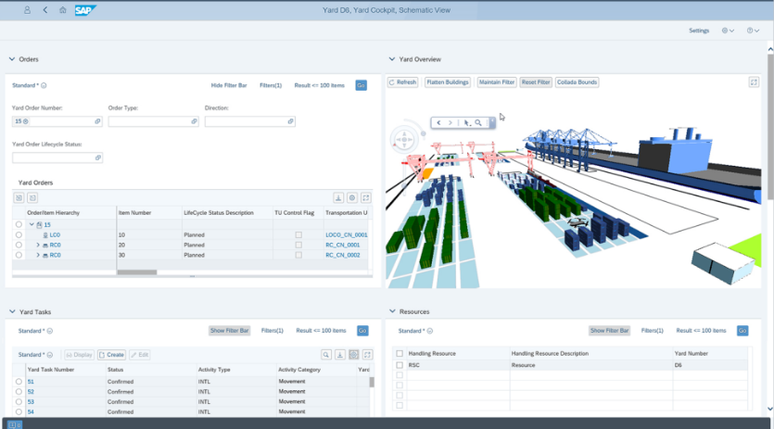
Example 2: Yard Management & Gate Scheduling
Outcome/goal: Lower yard dwell time (waiting in yard), fewer bottlenecks at gates.
Architecture:
Business: Average dwell time < 45 minutes. Dock utilization > 85%
Information: Appointments, vehicle arrivals, check-in events, dock status.
Applications: Yard Management System (YMS), Automatic Number Plate Recognition (ANPR) or QR scanning at the gate, dock scheduler, TMS, Guard user interface.
Technology: Edge cameras with ANPR, Local rules engine, Events sent to broker and YMS, API for carriers to book time slots.
Flow: Carrier books a slot → ANPR system auto-checks in truck at the gate → YMS assigns a dock → WMS triggers unloading task → completion event updates carrier.
Pitfalls: Dirty license plates or poor lighting at gate, no offline mode if gate system fails, overbooking without time buffers.
local rules engine: on-site decision system that applies business rules automatically, even without cloud connection.
YMS suite of SAP
Notes:
A Guard User Interface (Guard UI) is the software screen or dashboard used by security staff at the warehouse or yard gate.
It’s designed for gate operators / guards, not planners or warehouse staff.
It shows real-time information about vehicles arriving, checking in, and leaving.
Typical features:
View today’s appointments / booked time slots.
Check truck or trailer details (license plate, carrier, driver).
Confirm check-in / check-out.
See dock assignments (where the truck should go).
Get alerts or exceptions (wrong license plate, missing booking, overbooking).
Sometimes it also integrates with ANPR (Automatic Number Plate Recognition) or QR scanners, so the guard just confirms what the system detects.
In short: Guard UI = the control screen at the yard/gate for security staff to manage and monitor truck entries and exits.
A Local Rules Engine is software that runs close to the devices (on-site, not in the cloud) and automatically applies business rules to incoming data.
“Rules engine” = a system where you can define if–then–else rules, without rewriting code.
“Local” = it runs on a computer or server at the warehouse/yard, so it works even if the internet/cloud connection fails.
Example in yard management (gate):
Rule: If truck arrives more than 30 minutes before its booked slot → put it in waiting area.
Rule: If license plate does not match booking → alert guard.
Rule: If dock is free and truck is checked in → assign dock automatically.
Why local?
Low latency: decisions are made immediately.
Offline resilience: the gate can still function if the cloud system is down.
Less network dependency: avoids delays from sending every small event to the central system.
→ In short: a local rules engine = a small on-site decision system that applies business rules automatically, even without cloud connection.

Slide 34

What do you know?
Smart Logistics
Write down all the systems, platforms and tools that a supermarket like FreshWay uses to control their logistics

Slide 35
Program of today
Smart Logistics
Architecture
Logistic systems
Data flow diagrams
Data analyses
Platforms

Slide 36
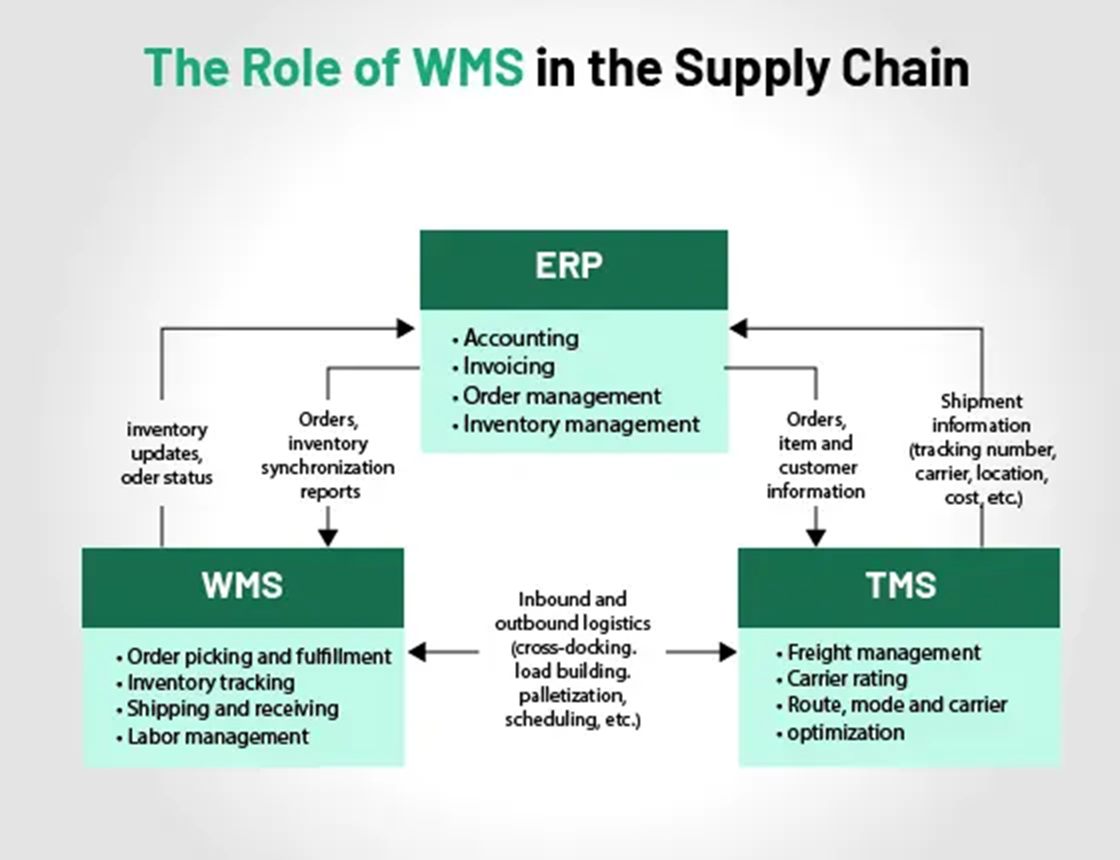
Logistics Core Systems
ERP
  Integration of inventory, sales, finance, HR, procurement
WMS
  For warehouse processes: Incoming and outgoing goods, order picking, returns
TMS
  Transport planning, ride optimisation, callaboration with transporters
POS (Point of Sale)
  Checkout and sales systems for realtime sales and inventory updates
E-business platform
  Online sales of groceries
  Customer communications

Slide 37
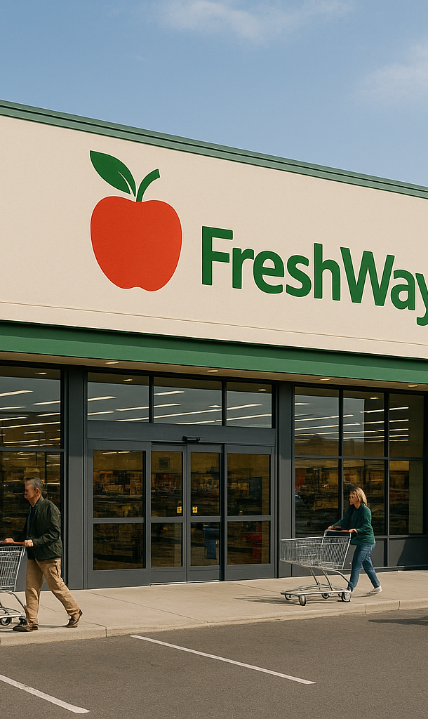
Inventory & demand prediction
Demand forecasting tools
  For forecasting demand based on trends and patterns
Replenishment tools
  Forecasting inventory levels based on historical data

Slide 38

Core relationships
Electronic Data Interchange (EDI)
  Connection with supplier systems
Supply chain visibility platforms
  For tracking the flow of goods

Slide 39
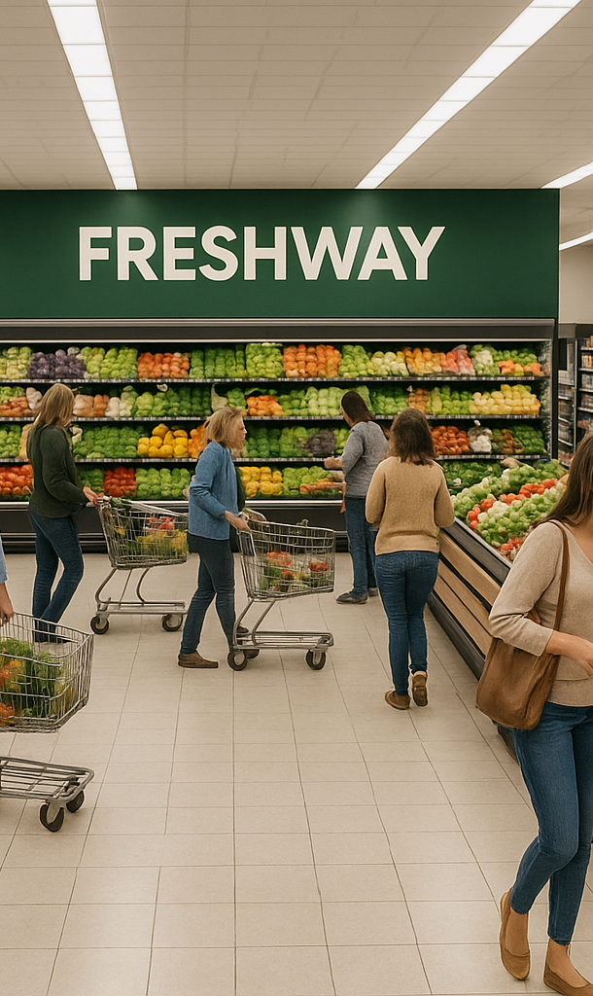
Shop & DC tools
Shelf management tools
  For shelf management and optimisation of store configuration
Hand scanners & voice picking
  For inventory replenishment and order picking
Self scanning & checkout technology
  For (self) checkout of groceries in stores

Slide 40
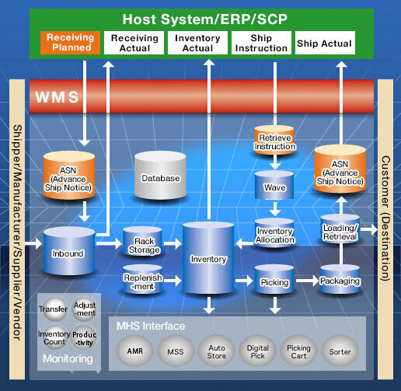
Core systems - Architecture

Slide 41
From forecast to checkout: steps, systems, data
FreshWay, stores
Step
Department
System
Data file
Forecast and order
Inventory & SCM
Forecasting, ERP
demand_inventory
Receive at the dock
Incoming transport
WMS, EDI
inbound_receipts
Put away and store
Storage
WMS
site_energy_hourly
sales data, next morning
Pick for the store
Orderpicking
WMS
pick_lines_sample
Drive to the store
Outbound transport
TMS
store_replenishment
Sell at the checkout
Store
POS
demand_inventory
Data files: FreshWay dataset, ISO week 42 of 2024 to week 2 of 2025. Source: Company dossier A5, Dataset guide.
Notes:
New slide, no predecessor. Source: FreshWay Company dossier A2 and A5 (IT landscape, as-is) and the Dataset guide. Only public documents: nothing from the department files, which each department sees on its own.
This is the generic core-systems picture from the previous slides, applied to FreshWay. Read it top to bottom: the goods go down the steps, one department per step, and every step runs on a system that leaves data behind. The right-hand column is the file they received at the end of lesson 2, so every department can find its own row.
Point at the dashed arrow. The goods move forward, but the information that drives the next order comes back from the till. That return trip is a nightly batch: the forecast works with yesterday's sales. That is the bridge to data driven logistics: the data exists, the question is when it arrives and who can use it.
Ask: which department owns the step where your file is made, and who reads it after you? That second department is where their data flow diagram continues.

Slide 42
From click to front door: steps, systems, data
FreshWay, online
Step
Department
System
Data file
Order, choose a slot
E-commerce
Webshop, OMS
home_delivery_orders
Pick into crates
Orderpicking
WMS
pick_daily_summary
Plan and drive
Delivery to consumers
Route planning
delivery_routes
Hand over
Delivery to consumers
At the door
home_delivery_execution
order_id joins the promise (row 1) and the execution (row 4): two departments.
About 18% is click & collect: no van, so no row in the execution file.
Source: Company dossier A2 and A5, Dataset guide.
Notes:
New slide, no predecessor. Source: FreshWay Company dossier A2 and A5, and the Dataset guide (keys, click & collect).
The online flow is shorter but crosses more department borders per order. The customer makes the promise in the webshop (slot, basket), Orderpicking fills the crates, Delivery to consumers drives and hands over. Complaints and ratings are registered at the door, so they land with Delivery, even when the cause was a decision made earlier, such as a missing item.
The yellow box is the point of the slide for SA2. The promise sits in the E-commerce file, the execution in the Delivery file, and order_id is the key between them. 'Did we keep our delivery promise?' cannot be answered by either department alone. That is exactly where an Interface Agreement belongs.
Mention the click & collect trap: about 18% of online orders never go into a van, so they are in the orders file and not in the execution file. An inner join drops them without warning.

Slide 43
Where the information arrives late
FreshWay IT landscape, as-is
Supplier → dock
30% of suppliers send no electronic despatch advice
WMS → ERP
Nightly batch: no real-time stock view between the DCs
TMS ↔ WMS
Route plan and pick sequence are not linked
POS → forecast
Store sales arrive the next morning
Stock → webshop
The webshop shows stock 30 minutes late
Sensors
Data from DCs, trucks, vans and cabinets is stored, not used
Which of these rows crosses your department's step?
Source: Company dossier A5, IT landscape as-is (column 'Known pain').
Notes:
New slide, no predecessor. Source: FreshWay Company dossier A5, column 'Known pain'. All six are published to every department.
The previous two slides showed where data is made. This one shows where it gets stuck on its way to the next step: a batch that runs at night, a link that is missing, a supplier that sends nothing, sensor data nobody reads. None of these is a missing system. FreshWay has the systems; the problem is in the arrows between them.
That is also what their data flow diagram should show. Ask each department to find the row that crosses its own step, and to name who is waiting on the other side. Then go to the assignment on 'It's about the data'. Leave the solutions for lesson 4 and later: today the question is only where the information flow breaks.

Slide 44
It’s not about the tools!
But what is?

Slide 45
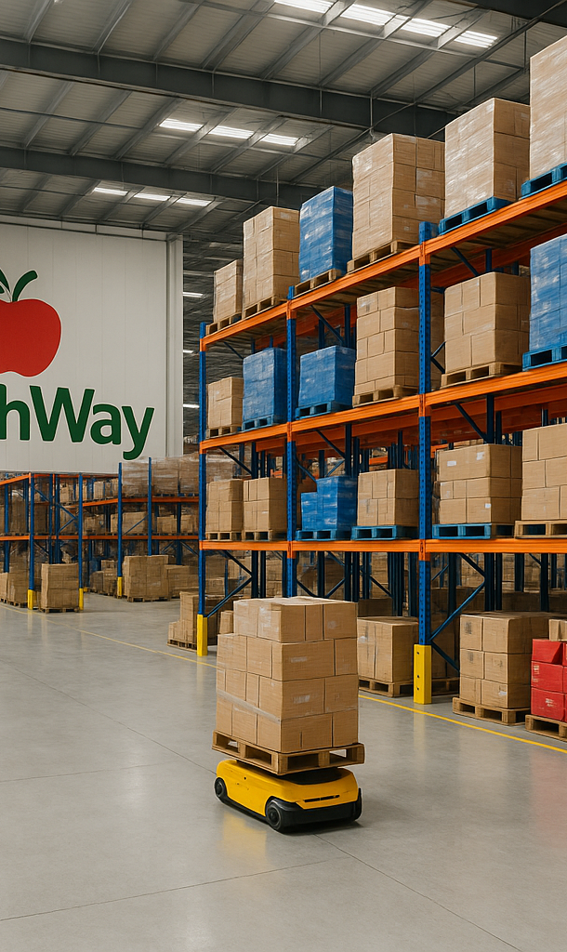
It’s about the data!
Assignment
  Work in your group
  What data from your department flows through the systems and tools mentioned?
  Where does the data come from?
  Where goes the data to?
  What key metrics are involved in the data?

Slide 46
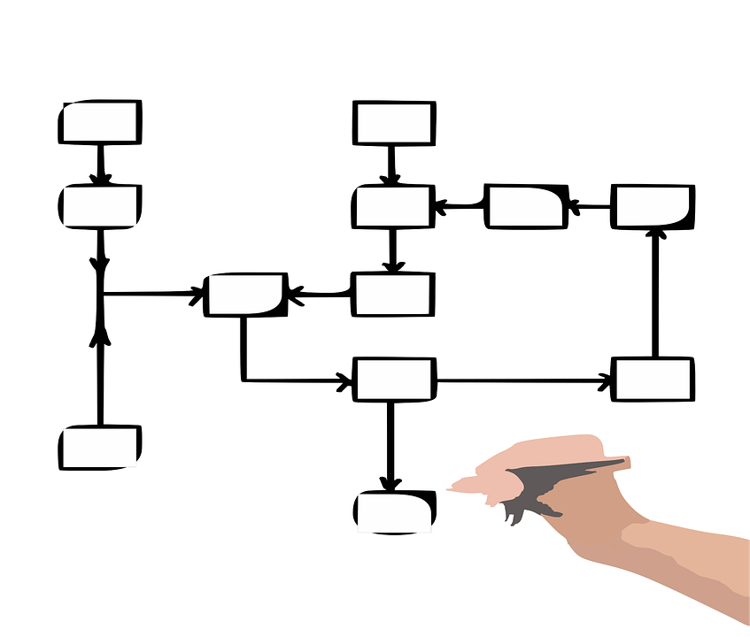
Data flow diagrams
Definition: A visual representation of how data moves through a system, showing inputs, processes, data stores, and outputs.
Purpose: To illustrate the flow of information and the interactions between different components without focusing on technical implementation.

Slide 47
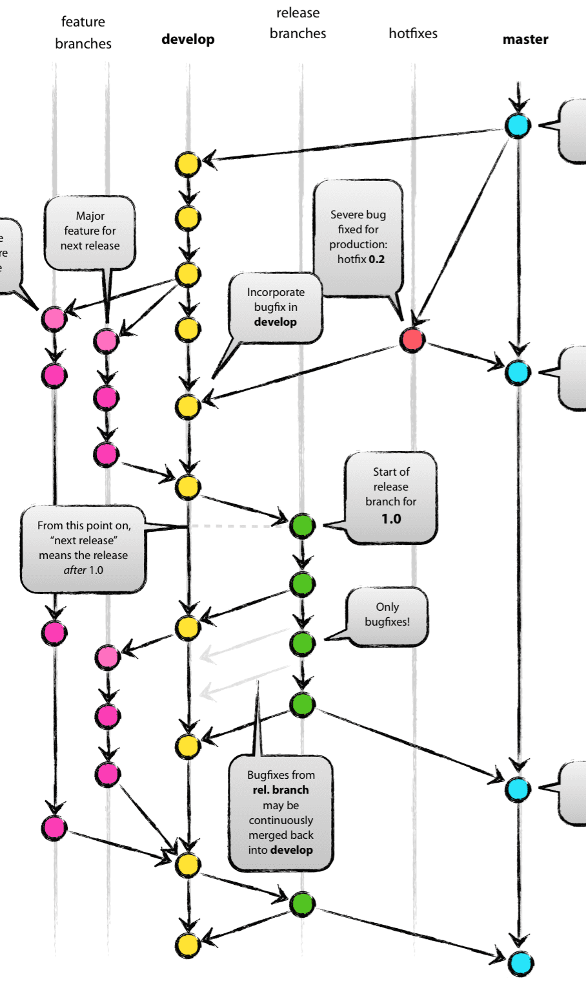
Data flow diagrams usage
Identify how data enters, is processed, and exits a system.
Reveal inefficiencies, bottlenecks, or missing connections in business processes.
Provide a clear, non-technical overview for stakeholders during system design or process improvement.
Levels: Can be drawn at different levels of detail (e.g., context diagram for a high-level view, lower levels for detailed processes).
Deze foto van Onbekende auteur is gelicentieerd onder CC BY-SA

Slide 48
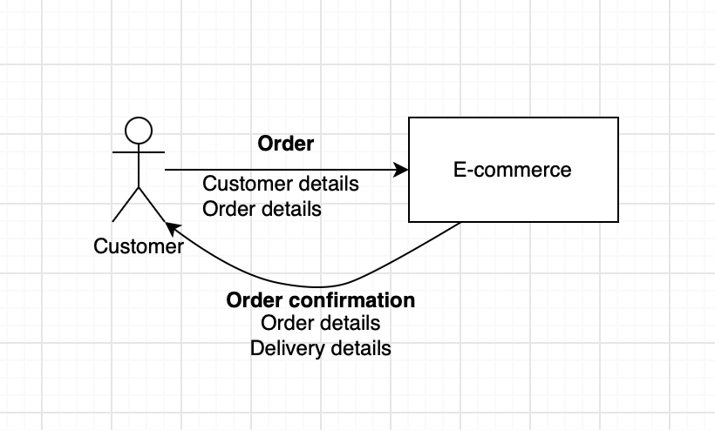
Data flow diagram
Application for FreshWays
https://drive.google.com/file/d/1SixsZ9IV14DIEVnFRldcVzPLoH3dVW8W/view?usp=sharing

Slide 49
Assignment
Work with your group
Login to the DFD on draw.io with your Google account
Add your department, and incoming and outgoing data flows to the diagram
Choose your own team colour for your department

Slide 50

But it is not about the data… (alone)
Smart Logistics
We have looked at examples of the use of data
But data is not the goal in itself!
So, what is?

Slide 51

It’s about the intelligence behind the data
Smart Logistics
Data is input for analysing and optimising the performance of the operation
  Operational data
  Financial data
  External data

Slide 52
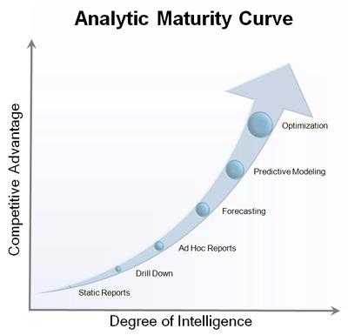
Data analysis at different levels
Smart Logistics
In data analysis, there are different levels of analysis.
The higher the level of analysis, the greater the competitive advantage that you can achieve with your data

Slide 53
Next sub-assignment
Portfolio
Create an overview of the data flowing through your department and create a data model to visualize the flow of this data
Connect your data flow to the other departments, so all the data flows from and to a logical actor or process
Make sure there are no loose ends

Slide 54
Next sub-assignment
Portfolio
Hand in your DFD next Monday at the latest
In the next lesson we give general feedback in class
This will give you an indication if you are on the right track
Prepare a presentation of max 3 slides for the next lesson
One group will be randomly selected to present next lesson
(if you don’t have to present you can use the presentation for the end assessment)

Slide 55
The first Interface Agreements
The five bodies · 35 minutes, all at the same time
In the Data Council
In the MT
1
Your Interface Map row: 2 to 4 partners
Delivered · needed · blocked
Draft the seven commitments
Finished? Listen in at a council
2
Agree per exchange: what, fields, format, owner
3
The receiving department signs once it says yes
Technology Council
Investment Council
Communication Council
How the systems connect, and what each department puts in and takes out
Where departments touch, and where an investment would be useful
How departments communicate now, and what we need for the coming weeks
A council that writes nothing down has not met.
Notes:
10:05 · 35 min · alle vijf de organen tegelijk
Deel vóór dit blok de Interface Map-kaartjes uit: elke afdeling alleen haar eigen rij, twee tot vier vaste tegenpartijen (sjabloon 12). Les 3 is de les waarin de kaart voor het eerst nodig is.
Data Council: de Data & Interface Officers maken de eerste Interface Agreements. De regels op de dia volgen sjabloon 7: wat er wordt uitgewisseld, welke velden, formaat, frequentie, eigenaar, en wat de ontvanger ermee doet. Tekenen doet de ontvangende afdeling, en pas als die ja heeft gezegd. SA2 bevat er twee; twee getekende afspraken zijn nodig voor criterium 5.
Technology Council: samen begrijpen hoe de systemen samenwerken, en wat elke afdeling in die systemen stopt en eruit haalt. Dat sluit aan op de systeemdia's uit de masterclass.
Investment Council: waar raken de afdelingen elkaar, en op welk van die raakvlakken is een investering nuttig?
Communication Council: hoe gaat de communicatie tussen de afdelingen nu, en wat is er nodig om de komende weken goed samen te werken?
MT: hetzelfde als elke les. Ronde geleverd · nodig · geblokkeerd, en de zeven toezeggingen in concept in de MT-notulen (who · commits to deliver · to whom · by when). Klaar? De manager luistert mee bij een council naar keuze en neemt niet over.

Slide 56
Department work: start your data model
Back at your own table · 30 minutes
1
Debrief: what did your council settle?
2
First flows on paper: what comes in, from whom, where it goes
3
Divide SA2: who draws what, by when
4
Your commitment, and which two departments sign your agreements
Your manager takes this to the Board close.
Notes:
10:40 · 30 min · docenten lopen rond
Het enige moment waarop de hele afdeling samen werkt. Vier taken, in deze volgorde. Eerst de debrief: iedereen vertelt in één minuut wat zijn council heeft vastgelegd, de Data & Interface Officer als eerste, want die komt terug met de afspraken over de Interface Agreements. Dan de eerste stromen van SA2 op papier: wat komt binnen, van welke actor of welk systeem, wat gebeurt ermee, waar wordt het bewaard en waar gaat het heen. Dan SA2 verdelen. Als laatste de toezegging, inclusief welke twee afdelingen de Interface Agreements tekenen.
Vragen bij het rondlopen, uit de lespagina: heeft elke pijl een naam? Begint en eindigt elke pijl ergens? Waar een pijl de afdelingsgrens over gaat, hoort een Interface Agreement.

Slide 57
Seven commitments, out loud
Board close · 5 minutes
“[Department] hands in SA2 by Monday, end of day,
with two Interface Agreements, to [dept] and [dept].”
Recorded in the MT minutes · the Board logs one line
Lesson 4 opens with the check on it, and with your Board Memo
Managers: hand in your Board Memo before you leave.
Notes:
11:10 · 5 min · beide docenten
Elke manager spreekt de toezegging uit in de vorm van de zin op de dia. De MT-notulen hebben er zeven rijen voor; de Board legt in de Board Decision Log één regel vast: de zeven toezeggingen voor les 4 zijn genoteerd.
De managers leveren voor ze weggaan hun Board Memo in (één A4 per les). Die komt in de Board opening van les 4 terug, samen met de doorloop van de toezeggingen.
Herhaal de afspraak van dia 'Next sub-assignment': SA2 inleveren maandag einde dag; de feedback komt in les 4 algemeen in de les, niet vooraf op dinsdag.

Slide 58
Next week
Portfolio
Feedback on your data flow models
Presentation of one plan (be prepared!)
Lesson Digital Developments

Slide 59
GenAI transparency
GenAI
These slides build on the 2025 course materials written by your lecturers. For 2026 the facts, figures and examples were checked and updated with GenAI support, and a number of slides were added.
Human-AI Agency Label: Creative Director — your lecturers set the structure and the line of reasoning; GenAI carried out specific parts within that frame, and every change was checked before it went in.
Labels source: Boetje, J., & Baake, G. (2026). Nine prototypical human-AI agency patterns [Figure]. figshare. https://doi.org/10.6084/m9.figshare.31706884 (CC BY 4.0).
Notes:
Afsluitende dia: de GenAI-verklaring bij dit deck. Kort benoemen dat wij als docenten zelf ook transparant zijn over GenAI-gebruik — hetzelfde als wat wij van jullie vragen bij het portfolio. Niet voorlezen; één zin volstaat.

